Slide 1
Dr.SNS RAJALAKSHMI COLLEGE OF ARTS AND SCIENCE (AUTONOMOUS) COIMBATORE-641049 Accredited by NAAC(Cycle III) with “A+” Grade Recognised by UGC, Approved by AICTE, New Delhi and Affiliated to Bharathiar University, Coimbatore.
DEPARTMENT OF COMPUTER SCIENCE
18UCS810: MOBILE APPLICATION DEVELOPMENT(Blended)
III YEAR - V SEM
UNIT 1 – INTRODUCTION TO ANDROID
TOPIC – History of Mobile Software Development

Slide 2
Outline
MAD:Definition
Device platforms
Mobile Development Approaches
MAD Lifecycle
History of MAD

Slide 3
Definition
Mobile application development is the process of creating software applications that run on a mobile devices

Slide 4
Device platforms
Platforms
Android
IOS

Slide 5
Mobile Application Approaches
There are four major development approaches when building mobile applications
Native Mobile Applications
Cross-Platform Native Mobile Applications
Hybrid Mobile Applications
Progressive Web Applications

Slide 6
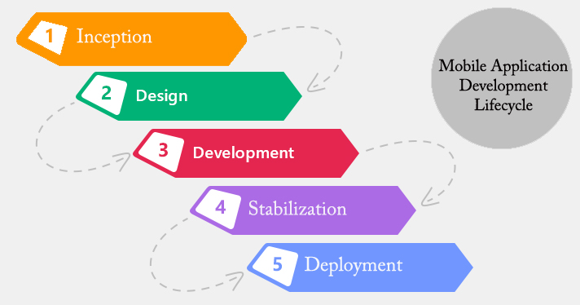
MAD Lifecycle

Slide 7
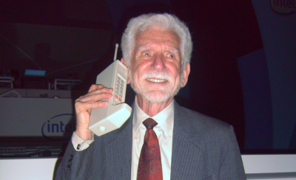
History of MAD
The first public cellular phone call was made by Martin Cooper of Motorola on 3rd April 1973 in a publicity stunt in New York

Slide 8
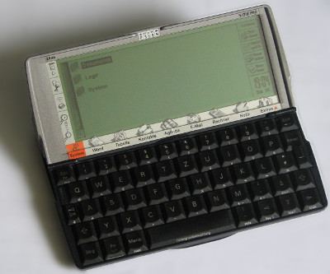
Psion EPOC
The first recognisable apps came with Psion’s range of handheld computers – mostly PDAs – that used the EPOC operating system.

Slide 9
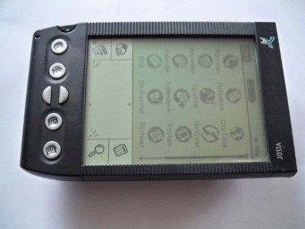
Palm OS
Palm emerged as a major rival to Psion in the PDA market with its cheaper, lower functionality range of PDAs – the Palm Pilot. Commercial success allowed Palm to release a new generation of machines in 1996 which utilised the Palm OS. This had a touchscreen GUI and came with a raft of basic apps as well as used C/C++ code.

Slide 10
WML
Wireless Markup Language was based on XML and was developed by the WAP Forum for use in Wireless Application Protocol enabled devices. It was lightweight and good for the low bandwidths you got with mobile devices back in the late 90s because it stripped out much of the HTML that requires processing power.

Slide 11
J2ME
As feature phones got faster the possibilities for phone apps expanded and it was Java Micro Edition that won the race to provide a platform for developing them.

Slide 12
Symbian
Symbian grew out of the Psion EPOC operating system. Originally developed by Symbian Ltd – a joint venture of Psion, Ericsson, Motorola and Nokia – the operating system was almost ubiquitous. In 2009 250 million devices were running Symbian.
It was Nokia that really drove the development of Symbian OS.

Slide 13
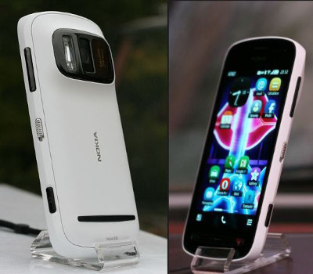
Contd..

Slide 14
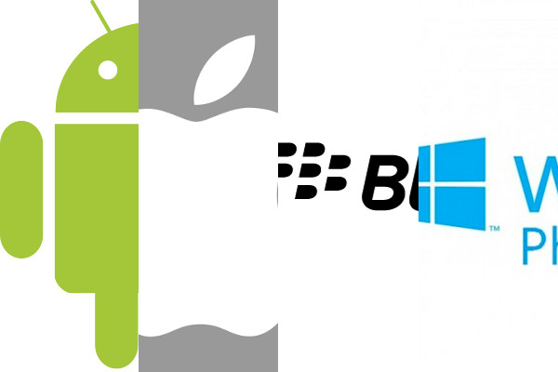
Android
The current state of Mobile Application Development

Slide 15
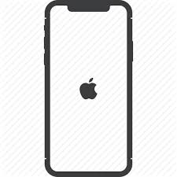
IOS
Apple’s iPhone set the standard for the new generation of smartphones when it was first released in June 2007 with its touchscreen and direct manipulation interface.

